Slide 1




HackOrbit 2025
CODE PIRATES

Slide 2

THEME & PROBLEM STATEMENT
Credit card spam detection tackles the critical issue of unsolicited digital communications, like emails or texts, designed to trick individuals into revealing their credit card information. This prevalent threat leads to significant financial losses, identity theft, and erodes trust in online transactions. The core problem is developing automated, accurate systems to identify and filter these deceptive messages, thereby protecting consumers from financial harm and bolstering the security of digital financial activities.

Slide 3
PROPOSED SOLUTION
Our Solution: Intelligent Credit Card Spam Detection
In an era where deceptive credit card communications pose a growing threat to financial security, our project presents an AI/ML-driven Credit Card Spam Detection System. We aim to safeguard users by leveraging advanced Natural Language Processing (NLP) and a hybrid model approach, combining the speed of traditional machine learning with the deep contextual understanding of transformer-based deep learning models like BERT. Our system will intelligently analyze emails and SMS messages, proactively identifying and filtering out sophisticated phishing attempts, deceptive offers, and unwanted solicitations that traditional filters miss. By building a robust, adaptive solution with continuous learning capabilities, we're not just detecting spam; we're building a crucial line of defense against financial fraud and restoring trust in digital financial interactions .

Slide 4
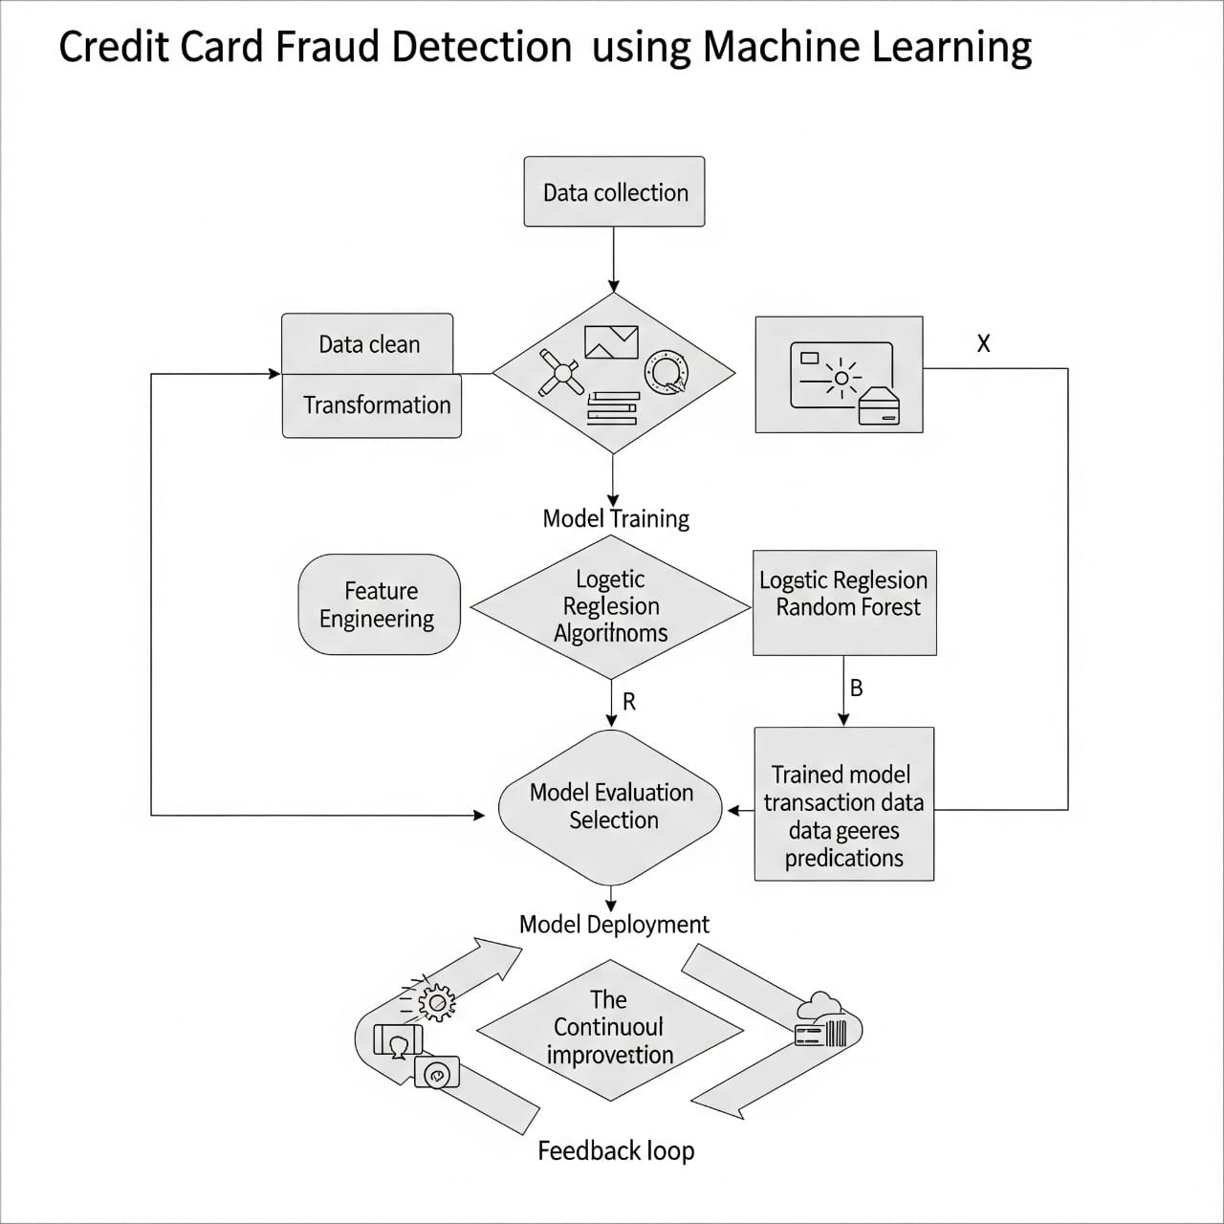
FLOWCHART / DIAGRAM

Slide 5
FLOWCHART / DIAGRAM
Essential Project Stages:
Data Gathering and Preparation:
Collect historical records of transactions, both fraudulent and non-fraudulent.
The data must undergo cleaning and transformation, ensuring it is primed for analysis.
Think about: Equipping an engine with the correct fuel blend for optimal performance.
Feature creation:
Generate additional, more insightful variables from existing data.
For instance, compute the rate of transaction anomalies or their volume.
Think about: Transforming raw ingredients into an exquisite gourmet meal.
Training and evaluation of the model:
Prepare datasets to train specific machine learning models such as Random Forest and Logistic Regression.
Estimate performance using F1-Score, Precision, and Recall.
Think about training the system to detect fraudulent transactions and evaluate its performance afterward.
*Deployment of the model:
Expose the best model to operational systems that require real-time processing.
The model analyzes incoming transactions to flag potential fraud.
Think about: Real-time systems monitoring transaction security using trained processes.
Feedback loop (Kaizen): * Monitor model performance and retrieve more

Slide 6
FEATURES AND NOVELTY
Key Features:
Data-Driven Pattern Discovery: Learns intricate, underlying fraud patterns directly from past transaction data.
Predictive Modeling: Employs ML algorithms to predict the probability of fraud for new transactions.
Adaptive Intelligence: Automatically learns and adapts performance as new data and fraud methods are introduced.
Scalable & Efficient: Is capable of processing enormous volumes of transaction data in real-time.
Novelty:
Beyond Static Rules: Transitions from strict, easily-evaded rule-based systems to dynamic, self-improving models.
Identifies Subtle Anomalies: Accurately identifies sophisticated and changing fraud patterns that human analysts or simple rules may not detect.
Reduced False Positives/Negatives: Provides better accuracy, reducing legitimate transactions being falsely blocked and real frauds being missed.
Proactive & Prophylactic: Moves away from reactive detection to proactive prevention by identifying suspicious behavior

Slide 7
DRAWBACK AND SHOWSTOPPERS
A credit card spam detection hackathon project faces several significant drawbacks and potential showstoppers, largely due to the inherent complexities of fraud detection and the constraints of a hackathon environment. A primary challenge is data imbalance, where legitimate transactions vastly outnumber fraudulent ones, making it difficult for models to accurately identify rare fraud patterns and often leading to high false negatives (missed fraud) or false positives (legitimate transactions flagged incorrectly). Data scarcity and quality also pose major hurdles; real-world credit card data is rarely accessible, and hackathon datasets are often synthetic or anonymized, lacking the granular features crucial for robust detection. Furthermore, the evolving nature of fraud patterns (concept drift) means that models quickly become outdated, a problem not easily addressed in a short hackathon. Other drawbacks include the "black box" nature of complex models, which hinders explainability crucial in financial contexts, and resource constraints (time and compute) that limit the depth of model development and optimization. Without careful attention to these issues, there's a high risk of overfitting to limited data and a lack of domain expertise among participants, further compromising the project's real-world applicability.
Several factors can act as showstoppers, completely halting or severely undermining the project's success. Inaccessible or unusable data is an immediate roadblock, as is being limited by insufficient computational resources for training complex models. A fundamental misunderstanding of the problem statement (e.g., confusing credit card fraud with email spam) will lead to an entirely misdirected effort. Crucially, failure to employ appropriate evaluation metrics (beyond simple accuracy, which is misleading for imbalanced datasets) can result in a model that appears effective but is useless in practice. Similarly, neglecting to address the class imbalance through specific techniques will inevitably lead to poor performance on the fraud class. Beyond technical challenges, unexpected library conflicts, environment setup issues, or unresolvable bugs can consume invaluable hackathon time, while scope creep (trying to implement too much) or poor team dynamics can derail the entire project.

Slide 8
CODE PIRATES
NAITIK JAIN ( Leader) ( Python developer )
EMAIL : naitikjain1706@gmail.com
ARYAN SHRIVASTAVA ( Front end developer )
EMAIL : aryanshrivastava3385@gmail.com
HARSH VARDHAN SINGH BAIS (Back end developer )
EMAIL : ish0001u@gmail.com
ADITYA RAWAT ( Content Writer )
EMAIL : adityarawat24sbl@gmail.com

Slide 9
Thank you

